Slide 1
BIOE 498 / BIOE 599: Computational Systems Biology for Medical Applications CSE 599V: Advancing Biomedical Models Lecture 1: Introduction and Biochemistry Basics
Joseph L. Hellerstein*
Herbert Sauro**
*eScience Institute, Computer Science & Engineering
**BioEngineering
Notes:
Diverse students. Some with bio-backgrounds; some without. Some with CS background; some with very limited. Two separate courses combined because of a substantial shared curriculum.

Slide 2
Agenda
Course Introduction & Overview
Biochemistry basics

Slide 3
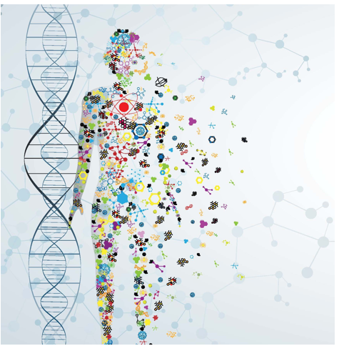
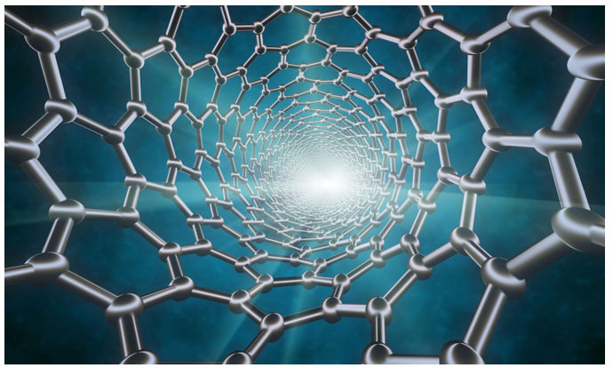
Why Biomedical Engineering?
Precision Medicine
Novel Materials

Slide 4
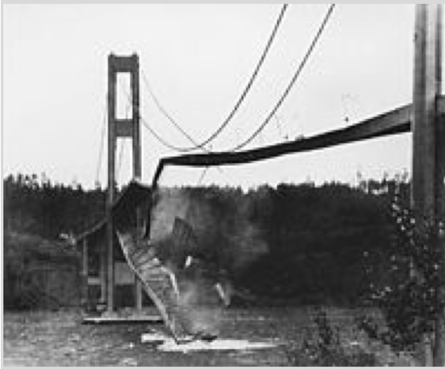
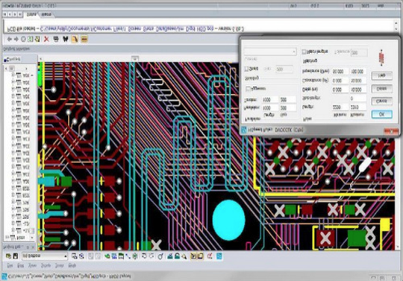
Why Models?
Disasters should occur in silico,
not in vivo.
Emulate experience with hardware design.
(Learning about eigenvalues the hard way.)

Slide 5
Scientific Goals of Modeling in Biology++
To explain biological processes that result in observed phenomena
To predict previously unobserved phenomena
To identify key generic mechanisms
To guide experiments:
Suggest new experiments
Help interpret experiments
Experiments are limited in number and control, computer simulations can test many more perturbations to explore their consequences
++ James A. Glazier, Biocomplexity Institute Intelligent Systems Engineering, Indiana University, Bloomington, IN

Slide 6
Course Goals
BIOE & CSE: Develop skills with building quantitative models of biological systems.
CSE: Develop a research agenda for developing tools for modeling biomedical systems.

Slide 7
Instructors
Herbert M Sauro, Associate Professor BIOE
PhD in Systems Biology
Research
Dynamics and operation of cellular processes
Clinically reliable approaches to modeling complex systems
Joseph Hellerstein, Senior Fellow eScience Institute, Affiliate Professor CSE
PhD in Computer Science
Industry (30+ years): IBM Research, Microsoft, Google
Mathematical models of distributed computing systems
Research
Model Engineering (tools for building biomedical models)

Slide 8
BIOE 599/498 Objectives & Grading
Learning Objectives:
Explain the purpose and need for modeling in biomedicine.
Explain the basic conceptual approach used by a number of different modeling approaches.
Explain the modeling workflow and how modeling is an iterative process.
Implement basic modeling techniques such as model fitting, model selection and sensitivity analysis
Use the concept of uncertainty quantification and the limits of current modeling approaches.
Compare and contrast with other fields that model complex systems.
(For 599 only) Learn to critique published modeling papers.

Slide 9
BIOE 599/498 Objectives & Grading
Grading
30% One assignment every two weeks
20% Weekly short quiz
20% Midterm stress testing
30% Final stress testing of models

Slide 10
CSE 599V Objectives & Grading
Learning objectives
Explain the need for biomedical models
Construct kinetics models of simple biological systems
Describe a software tool that addresses at least one common problem in building biomedical models.
Grading
Homework: 20%
Paper review: 30%
Course project: 50%
See https://modelengineering.github.io/advancing-biomedical-models/ for course details.
Lecture notes will be linked from the syllabus page.

Slide 11
Software
The class will feature in-class exercises, so please bring a laptop to class
Software: Tellurium (http://tellurium.analogmachine.org/)
For detailed installation instructions see https://github.com/sys-bio/tellurium#installation-instructions
For a huge database of curated models see:
https://www.ebi.ac.uk/biomodels/

Slide 12
Syllabus By Week
Joint
BIOE
CSE 599V
1
4
8
8
Basics of Biochemistry & Modeling
Fitting Parameters & Debugging Models
Case Studies
Model Engineering Overview & Survey
2
5
9
9
Systems Biology Modeling
Uncertainty in Models & Parameters
Ensemble Modeling
Model Engineering Tools
3
6
Modeling Workflows & Standards
10
10
Build a Model
Pharmaco- kinetics
Student Research Proposals
7
Student Reviews of Modeling Papers

Slide 13
Technical Statement of Course Objectives
BIOE & CSE: Develop skills with building kinetics models that quantify cellular processes operating through biological networks that create and destroy biomolecules and biomolecular complexes.
The remainder of today’s lecture will explain each of the underlined terms.
Notes:
This lecture is about what we will model. Next lecture is the how of modeling.

Slide 14
Biochemistry Basics
A brief history of life, its organization, and processes.
Structure of a cell
Biomolecules, biomolecular complexes, enzymes
Kinetics models
Biological networks

Slide 15
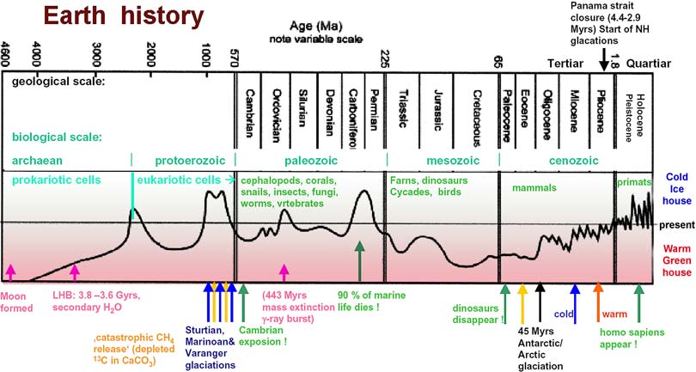
sciencemax.pbworks.com
Notes:
Simple life happened very early, within 0.5B years.
Complex cells took another 2.5B years
After Eukaryotic cells developed, quickly get multi-cellular organisms.

Slide 16
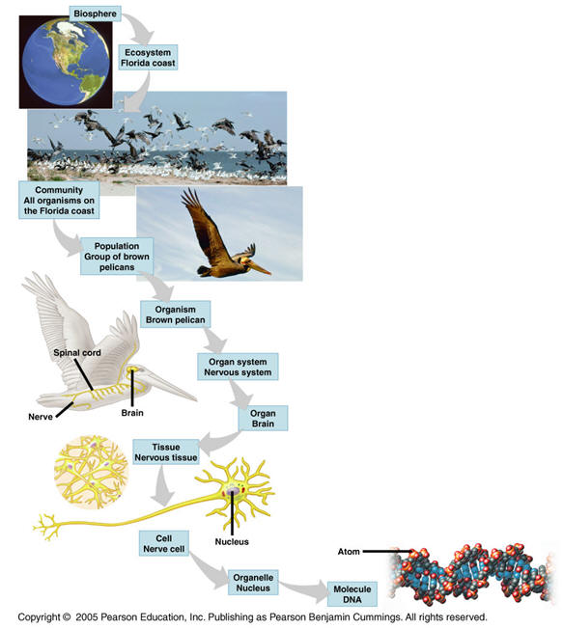
Levels of organization of life
DNA controls much of the chemistry of life.

Slide 17
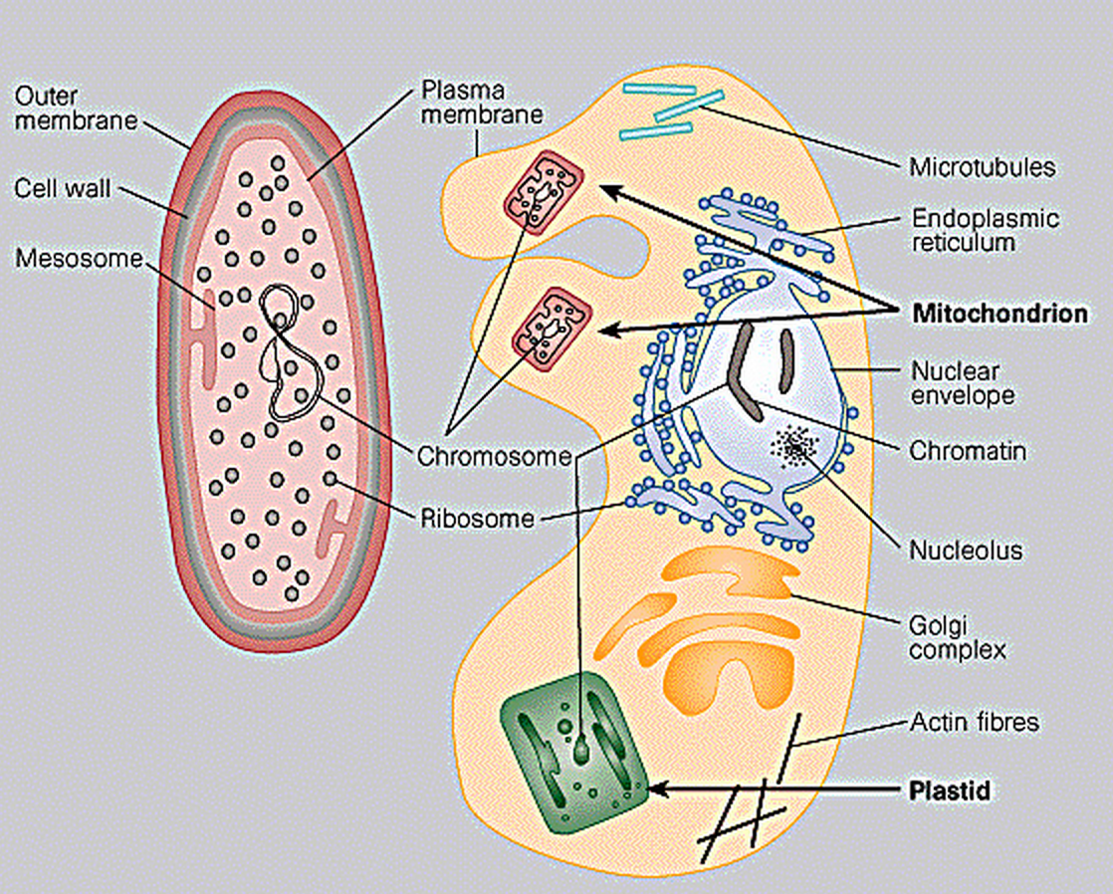
Prokaryotes (3.5B)
0.2-20 microns
0.2-20 microns
10-100 microns
10-100 microns
Prokaryote
Eukaryote
Eukaryote

Slide 18
Prokaryotes (3.5B) vs. Eukaryotes (1.5B)
0.2-20 microns
0.2-20 microns
10-100 microns
10-100 microns
Prokaryote
Prokaryote
Eukaryote
Eukaryote

Slide 19
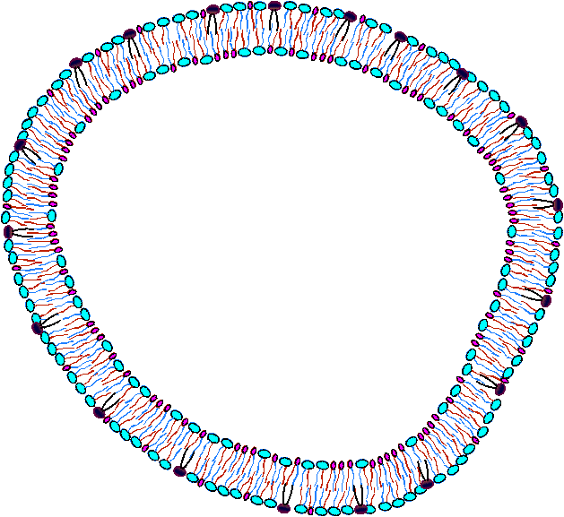
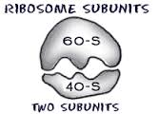
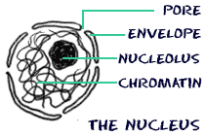
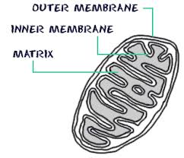
Simplified Cell Structure
Plasma membrane – controls entry and exit of molecules
Cytosol – interior of cell minus the organelles & locus of many pathways
Ribosome – constructs proteins from mRNA created in nucleus
Nucleus – exports mRNA and other molecules
Mictochondrion – Locus of key energy pathways

Slide 20
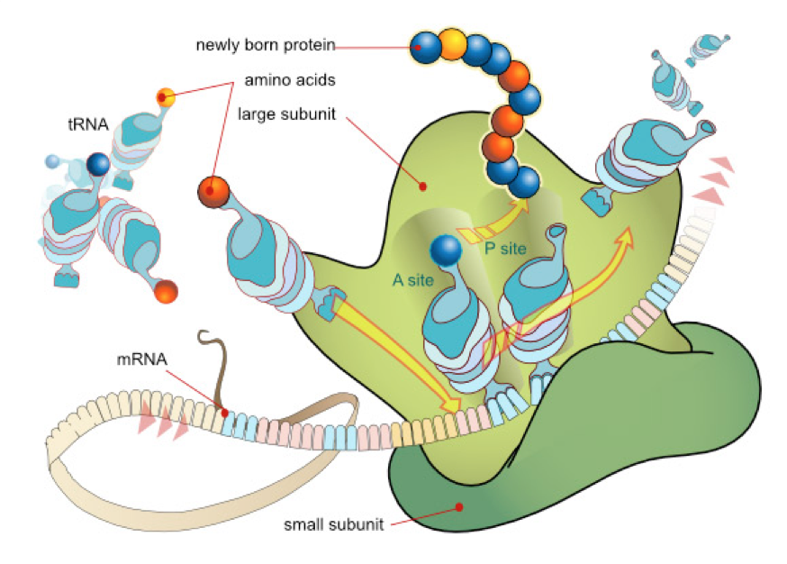
Pop Quiz: What’s This?

Slide 21
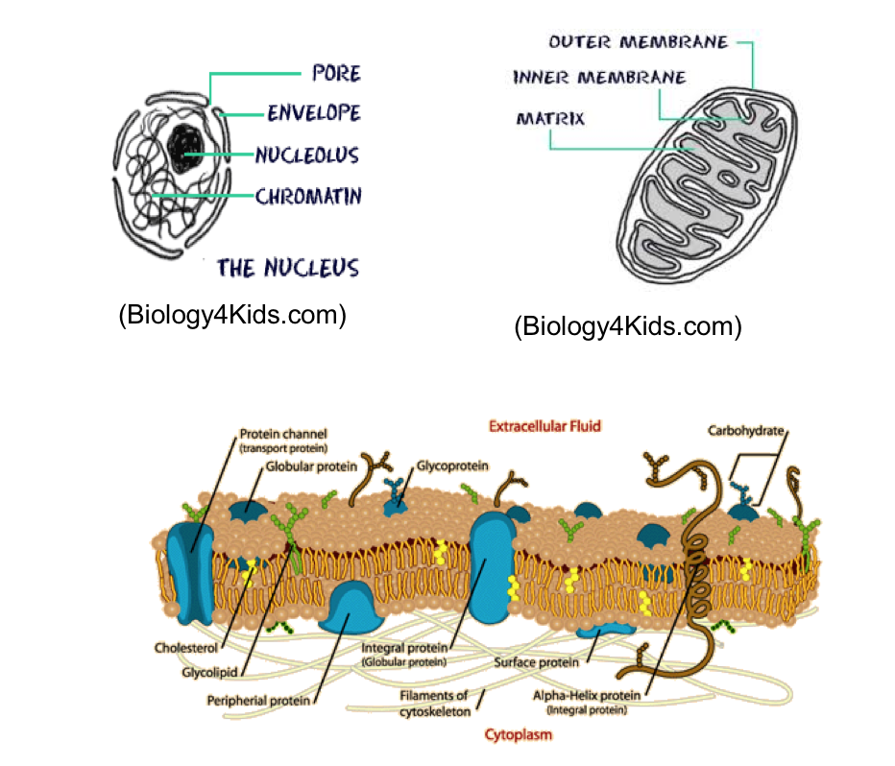
Substructures
Mitochondrion
(Biology4Kids.com)
(Biology4Kids.com)
Cell Membrane
(http://hyperphysics.phy-astr.gsu.edu/hbase/biology/celmem.html)

Slide 22
Some Cellular Processes
Build and degrade structures
Replicate (mitosis)
Metabolize
Take in food; transform it into cell energy
Expel molecules (e.g., waste)
Locomotion
Done by a sequence of chemical reactions (pathways) on biomolecules.

Slide 23
Key Biomolecules
Hydrocarbons (Aliphatic molecules)
Carbohydrate
Lipid
Protein
Nucleic Acid Polymers (RNA, DNA)

Slide 24
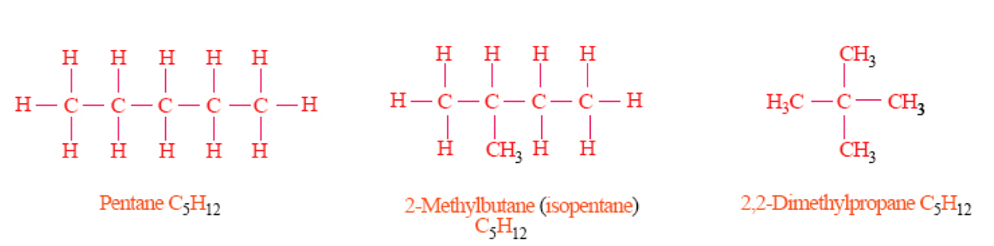
Hydrocarbons
Only Carbon & Hydrogen
Starting point for building biomolecules
Uses
High energy

Slide 25
Lipids
Polar head group plus chains of hydrocarbons
Uses
Energy storage
Membranes

Slide 26
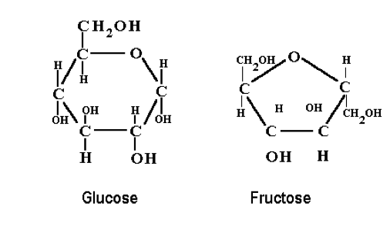
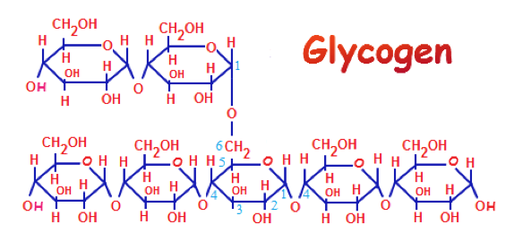
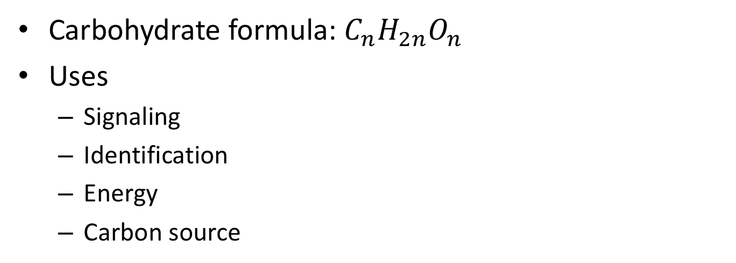
Carbohydrates
Carbohydrate formula: $C_{n}H_{2n}O_{n}$
Uses
Signaling
Identification
Energy
Carbon source

Slide 27
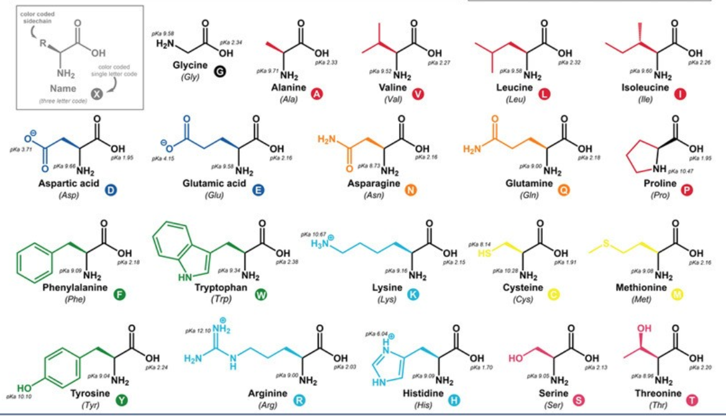
Protein
Amino Acids
Protein building blocks
Determines protein structure
Determines protein activity
Protein
Enzymes – help transform biomolecules
Transcription Factors (TF) – modify gene activity
Signaling
Cellular structures

Slide 28
Nucleotides
No 2’ O => deoxy
Has 3 parts: nitrogenous base, ribose (sugar), Phosphate
Notes:
Adenine

Slide 29
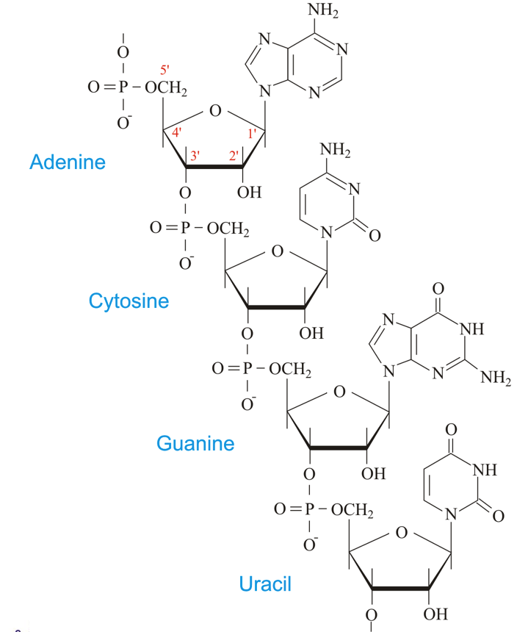
Ribonucleic Acid (RNA)
Phosphate group connects the nucleotides
Directional: 5’ & 3’ ends
Nitrogenous bases are A, C, G, U

Slide 30
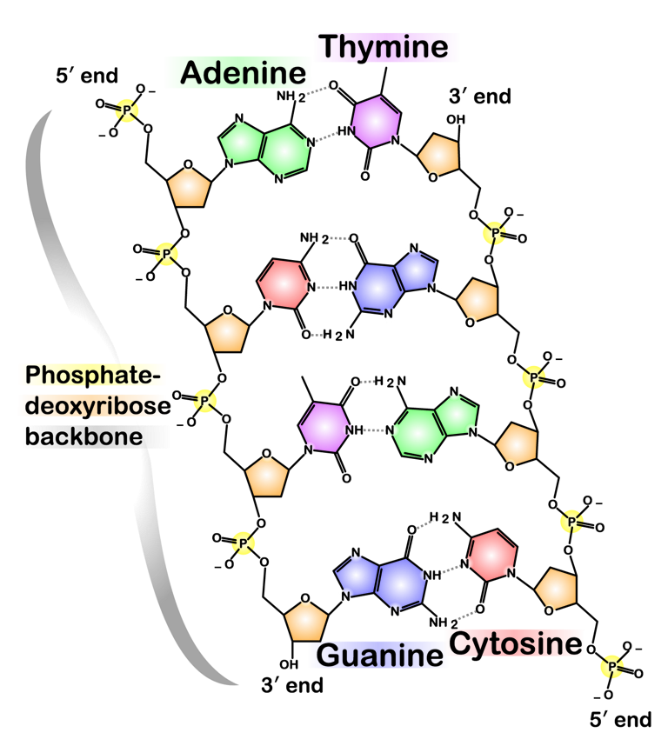
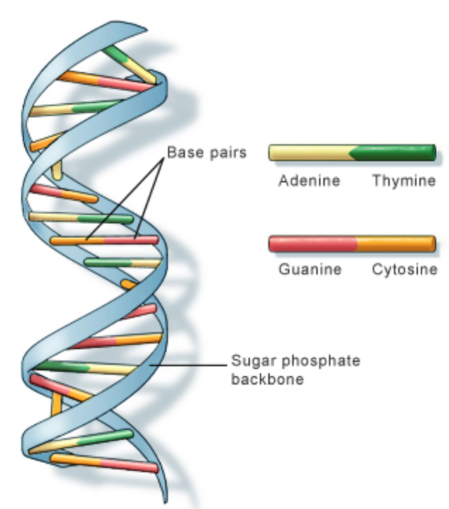
Deoxyribonucleic Acid (DNA)
Directional: 5’ & 3’ ends
Nitrogenous bases are G, C, A, T (not U)
Double stranded.
Hydrogen bonding between nitrogenous bases
Anti-parallel
Double Helix

Slide 31
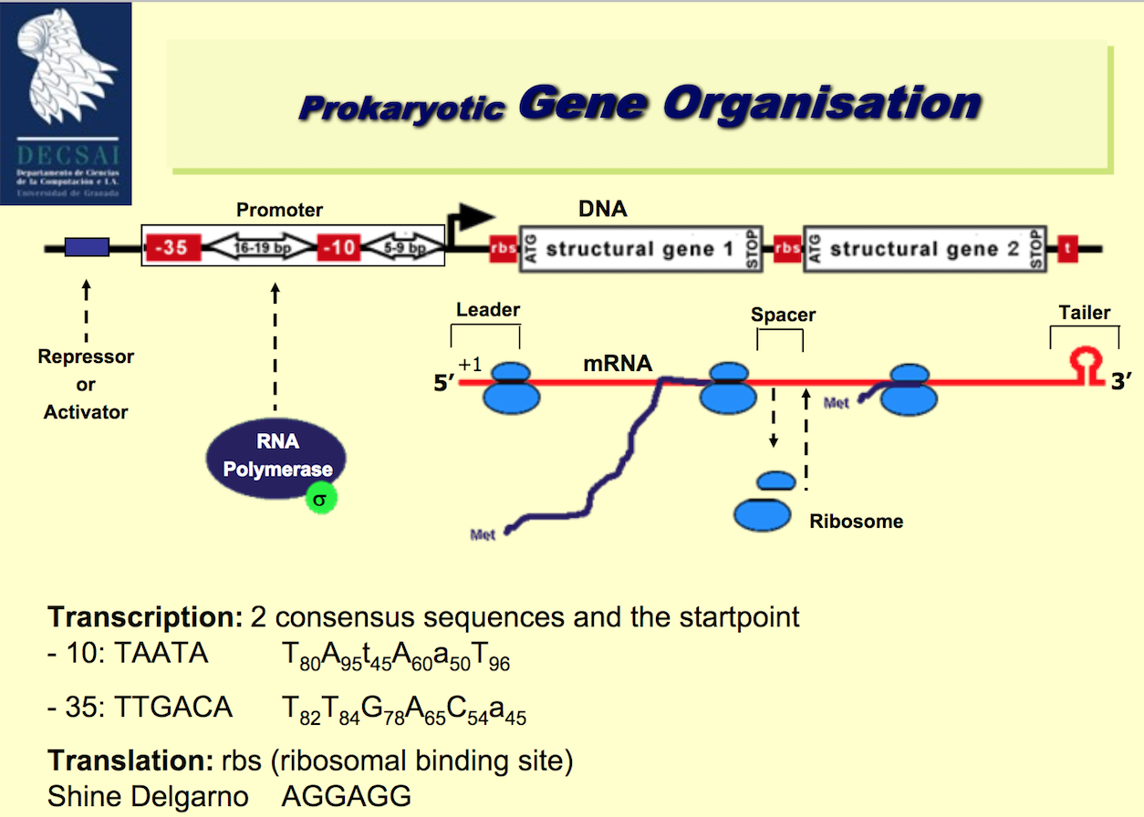

Slide 32
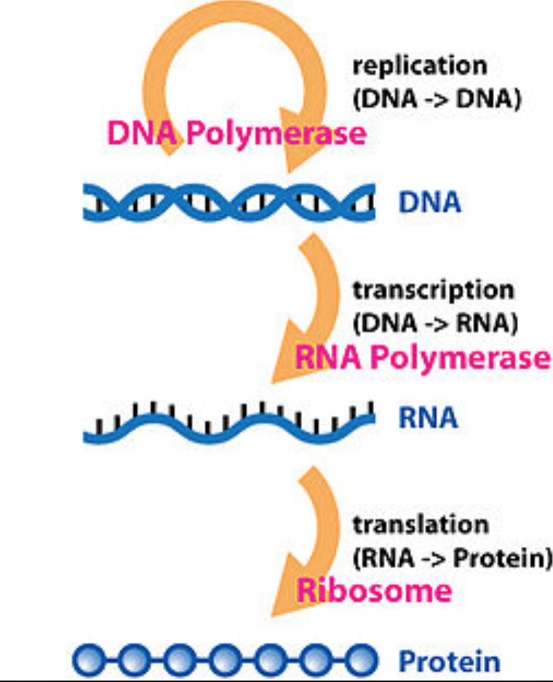
The central dogma relates DNA, RNA, and protein*.
*Wikipedia

Slide 33
Cells Contain Complexes of Biomolecules
Ribosome

Slide 34
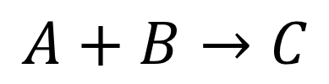
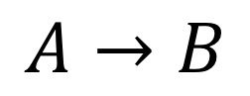
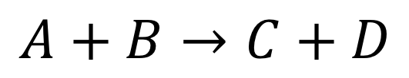
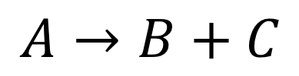
Chemical Reactions Create And Destroy Biomolecules
Reactants
Products
Reaction Types
$$A→B$$
Mono-Mono
$$A+B→C$$
Bi-Mono
$$A→B+C$$
Mono-Bi
$$A+B→C+D$$
Bi-Bi

Slide 35
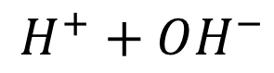
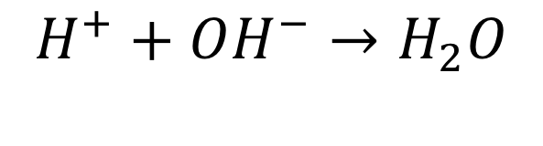
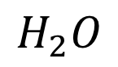
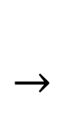
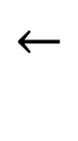
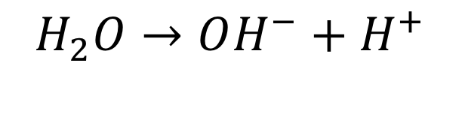
Examples
Type of reaction?
Reactants?
Products?
$$H^{+}+OH^{−}→H_{2}O$$
$$H_{2}O→OH^{−}+H^{+}$$
Type of reaction?
Reactants?
Products?
$$←$$
$$H^{+}+OH^{−}$$
$$←$$
$$H_{2}O$$
Reversible reaction
Notes:
These are likely the most important reactions in biology.

Slide 36
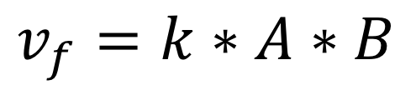
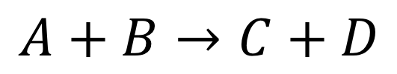
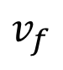
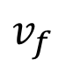
Chemical Kinetics Basics
How fast do reactions go:
Mass action kinetics
Constant times the concentrations of the reactants
$$v_{f}$$
$$v_{f}$$
$$A+B→C+D$$
$$v_{f}=k∗A∗B$$

Slide 37
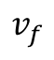
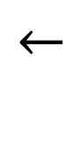
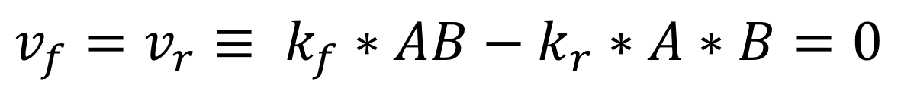
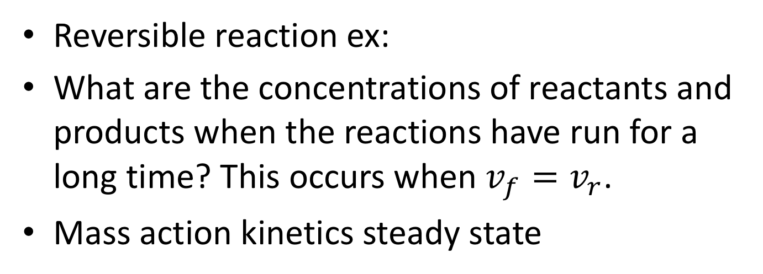
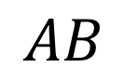
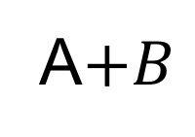
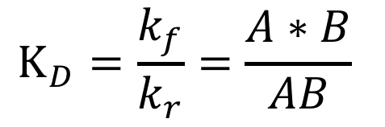
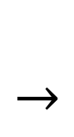
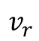
Reversible Reactions & Steady State
$$←$$
$$v_{f}$$
Reversible reaction ex:
What are the concentrations of reactants and products when the reactions have run for a long time? This occurs when $v_{f}=v_{r}$.
Mass action kinetics steady state
$$AB$$
$$←$$
A$+B$
$$v_{r}$$
$$v_{f}=v_{r}≡ k_{f}∗AB−k_{r}∗A∗B=0$$
Disassociation Constant
$$K_{D}=\frac{k_{f}}{k_{r}}=\frac{A∗B}{AB}$$

Slide 38
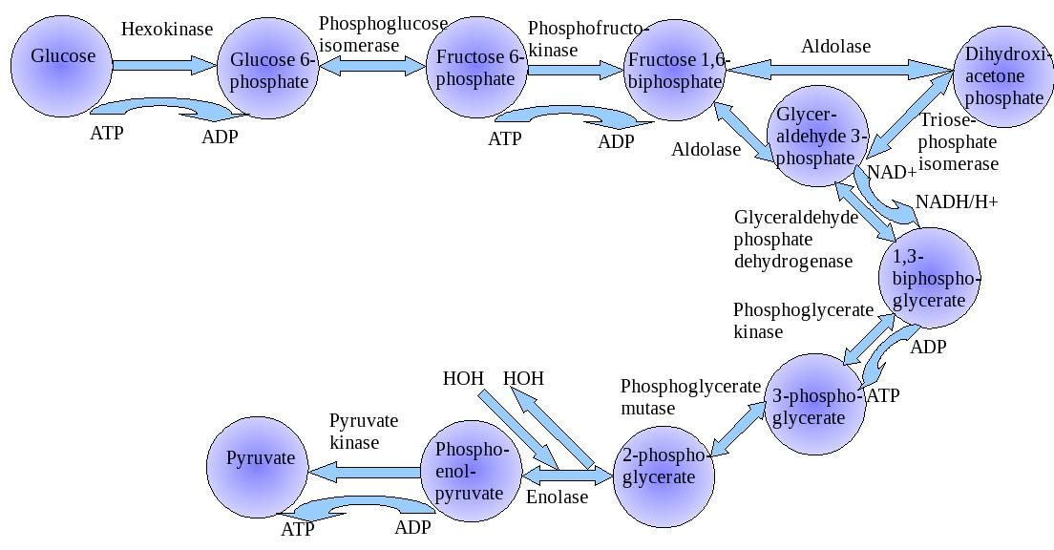
Biochemical Pathway: Collection of Reactions on Biomolecules
Glycolysis
Enzyme – protein that catalyzes a reaction

Slide 39
Biochemical Reactions
Reactant
Molecules
Product
Molecules
Enzyme
But Arcs are often bidirectional
(since chemical reactions can be reversed)
And enzymes may be modified in pathway regulation
(self-modifying code!)
Another Enzyme

Slide 40
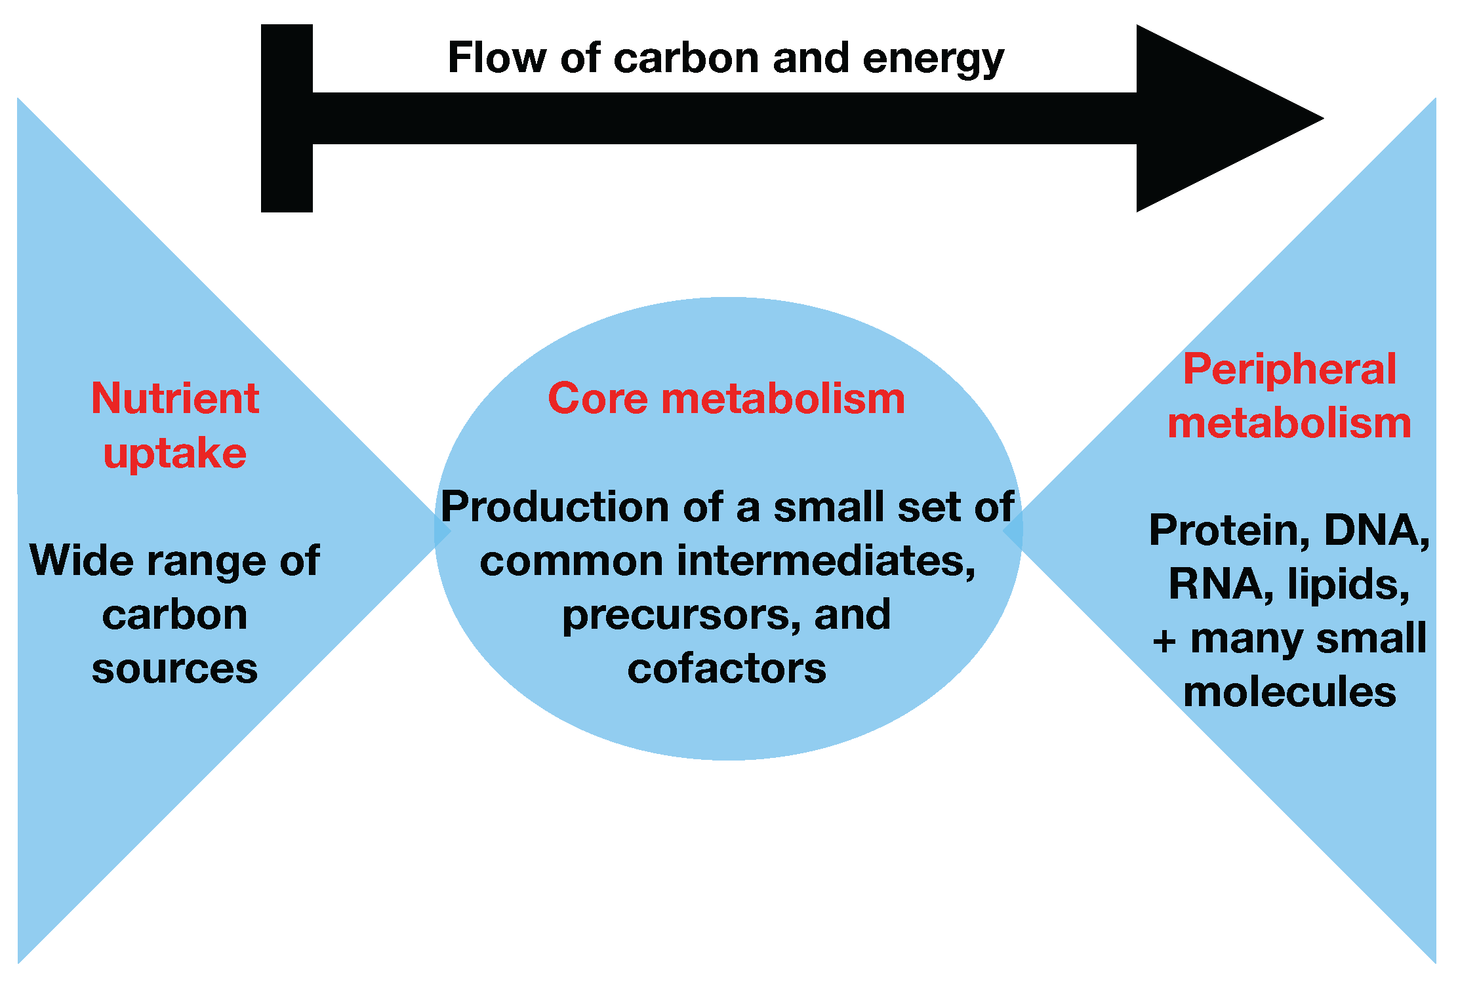
Metabolic Network++
A Metabolic network is a network of chemical reactions in a cell that transforms biomolecules to create energy, create cellular structures, and perform cellular processes.
Digestion of glucose and other nutrients into cellular components and energy production (mostly ATP—adenosine triphosphate and NADH—nicotinamide adenine dinucleotide) are the classic functions of metabolism
++ James A. Glazier, Biocomplexity Institute Intelligent Systems Engineering, Indiana University, Bloomington, IN

Slide 41
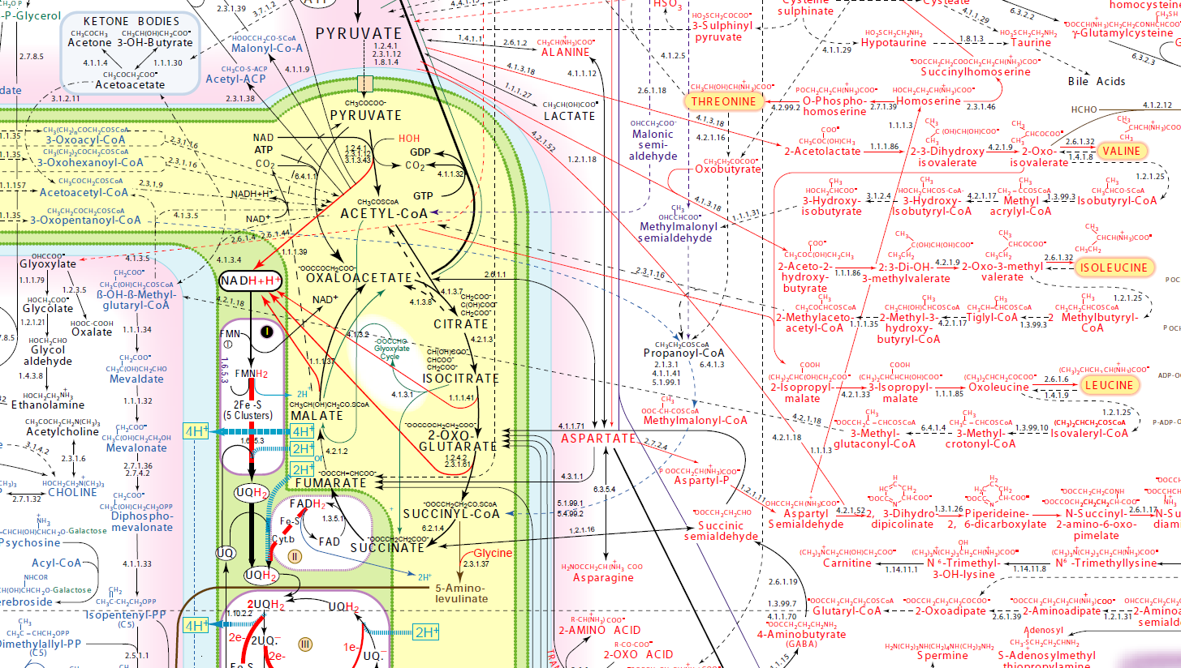
Detailed Metabolic Network
http://www.iubmb-nicholson.org/chart.html

Slide 42
Enzymes
Proteins that accelerate biochemical reactions.
Omni-present in biology
Enzymes work by induced fit.

Slide 43
Enzyme Inhibition

Slide 44
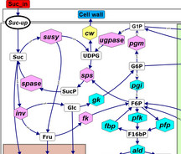



Biological Networks++
Chemical Reaction and Metabolic Networks that create and destroy chemical components of cells and tissues
Signaling Networks that transfer information between and within cells
Regulatory Networks that control the expression of genes and change cell types and behaviors
Physiologically-Based Pharmacokinetic Networks that describe the transport and processing of molecules throughout the body
++ James A. Glazier, Biocomplexity Institute Intelligent Systems Engineering, Indiana University, Bloomington, IN

Slide 45

Relationships Between Types of Network++
How does the identity of the active networks in the cell change if we make a controlled change?
How does the states of the cell’s active networks and cell behaviors change if we make a controlled change?
How does the production of cell components and energy change if we make a controlled change?
++ James A. Glazier, Biocomplexity Institute Intelligent Systems Engineering, Indiana University, Bloomington, IN
Notes:
Timescale will be important when we have to simulate two of these at once or if we want to know whether we can assume a signal from one level of network to be constant or equilibrated when we are simulating another scale

Slide 46
Modeling Questions: How Do Concentrations/Fluxes Change?
Environment: e.g. temperature, illumination, pressure
Substrate availability: e.g. glucose, O₂ level
Pathway structure, by adding, removing or changing the nature of a component: e.g. with a genetic knock, out or knock in, or a drug
++ James A. Glazier, Biocomplexity Institute Intelligent Systems Engineering, Indiana University, Bloomington, IN

Slide 47
Review
Define and give examples of:
Cellular process
Biomolecule
Biomolecular complex
Biological network
Kinetics model

